Slide 1

Project Title - Seasonal Agriculture Performance Analysis
Shree Shanth P B College Name - R V University
AICTE STU ID : STU6a68c2374a8b71785250359

Slide 2

PROBLEM STATEMENT
Agricultural activities are influenced by seasonal variations in environmental conditions, farming practices, resource availability and market conditions.
Raw agricultural data does not clearly explain how performance changes across seasons.
The problem is to analyze the given dataset and investigate seasonal differences in agricultural performance by identifying meaningful patterns, trends, relationships and variations in:
• Yield and production
• Resource usage and environmental conditions
• Revenue and profit

Slide 3
Project Description
This project performs Exploratory Data Analysis (EDA) on farm-level agricultural data collected across different seasons, geographical areas and farming conditions.
The analysis includes:
• Data understanding and data quality checks
• Missing value and duplicate treatment
• Feature and statistical review
• Univariate, bivariate and multivariate analysis
• Outlier and correlation analysis
• Seasonal comparison of environmental, production, resource and economic performance
• Additional student-driven analysis to derive insights and recommendations

Slide 4

WHO ARE THE END USERS?
• Farmers and agricultural planners
• Agricultural researchers and analysts
• Farm management teams
• Government and policy stakeholders
• Agricultural extension and advisory services
The analysis can help stakeholders understand seasonal variations, compare agricultural performance and support evidence-based planning and further investigation.

Slide 5

Technology Used
Programming & Analysis
• Python
• Pandas
• NumPy
Visualization
• Matplotlib
• Seaborn
Development Environment
• Google Colab / Jupyter Notebook
Version Control & Project Hosting
• GitHub

Slide 6
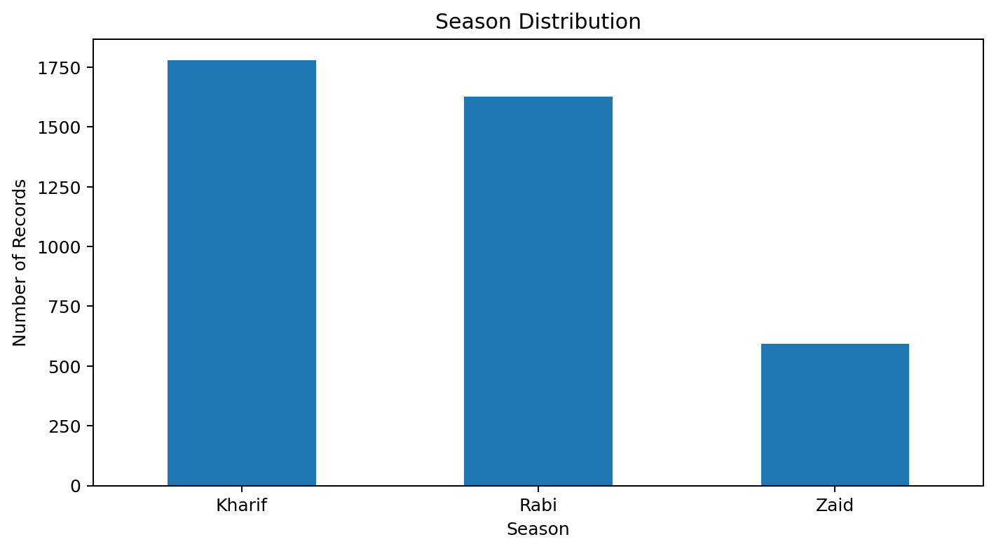
RESULTS
RESULT 1 – DATA & UNIVARIATE ANALYSIS The dataset was reviewed for structure, data quality, variables and descriptive statistics. The season distribution was visualized to understand how records are distributed across the available seasonal categories before deeper comparisons.

Slide 7
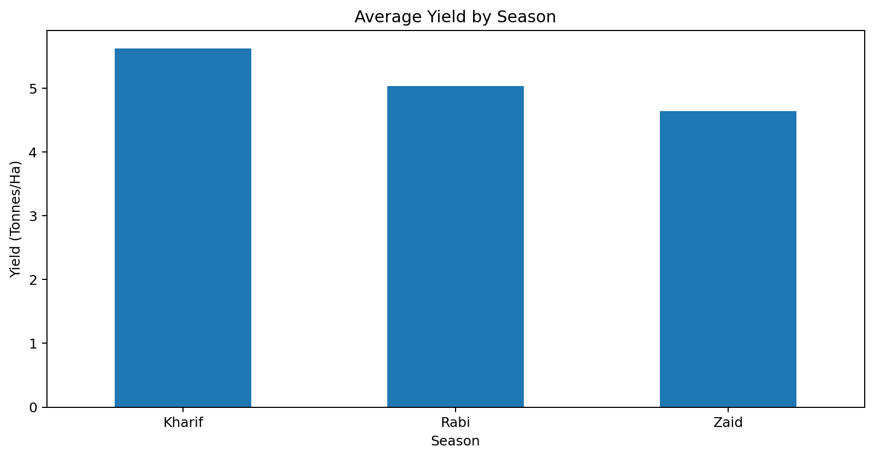
RESULTS
RESULT 2 – SEASONAL YIELD Kharif recorded the highest average yield at approximately 5.63 tonnes per hectare. Rabi followed at approximately 5.04, while Zaid recorded approximately 4.64 tonnes per hectare. This indicates a clear seasonal variation in agricultural yield within the available dataset.

Slide 8
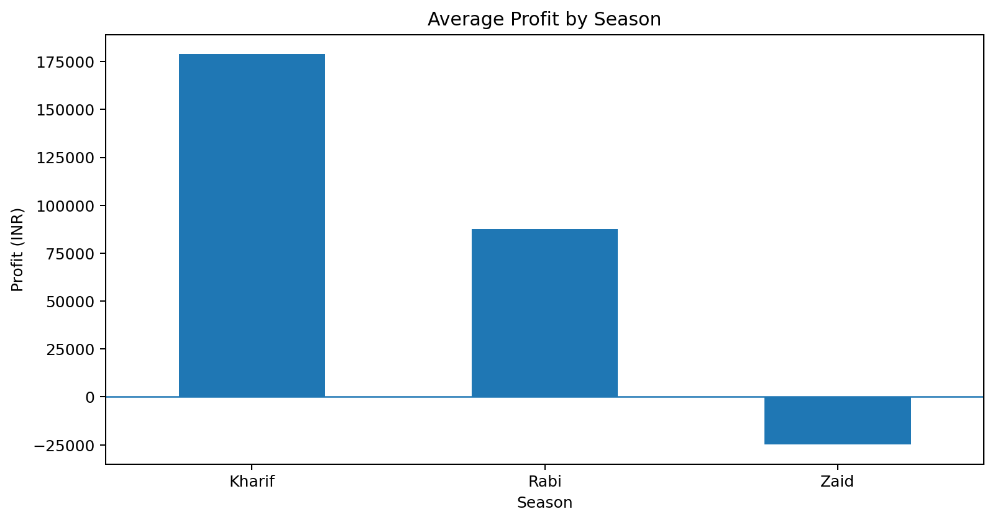
RESULTS
RESULT 3 – ECONOMIC PERFORMANCE Kharif recorded the highest average profit at approximately ₹178,914.65. Rabi averaged approximately ₹87,689.47, while Zaid recorded an average loss of approximately ₹24,804.82. The result highlights substantial differences in economic outcomes across seasons.

Slide 9
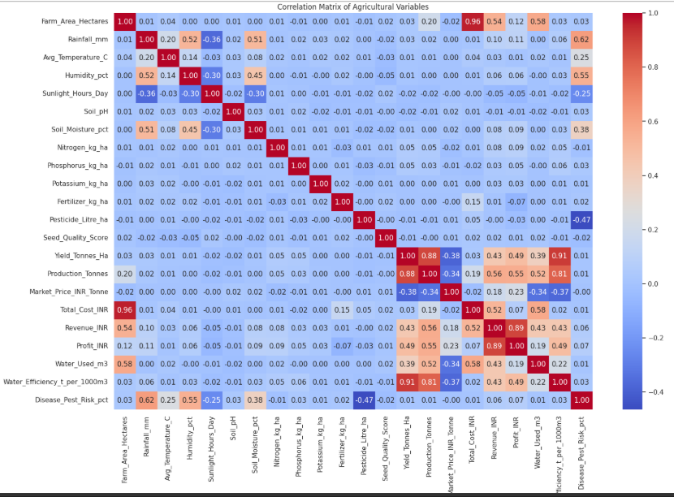
RESULTS
RESULT 4 – CORRELATION ANALYSIS Yield showed a strong positive association with: • Water efficiency (approximately 0.91) • Production (approximately 0.88) These are associations observed in the dataset. Correlation does not establish causation.

Slide 10
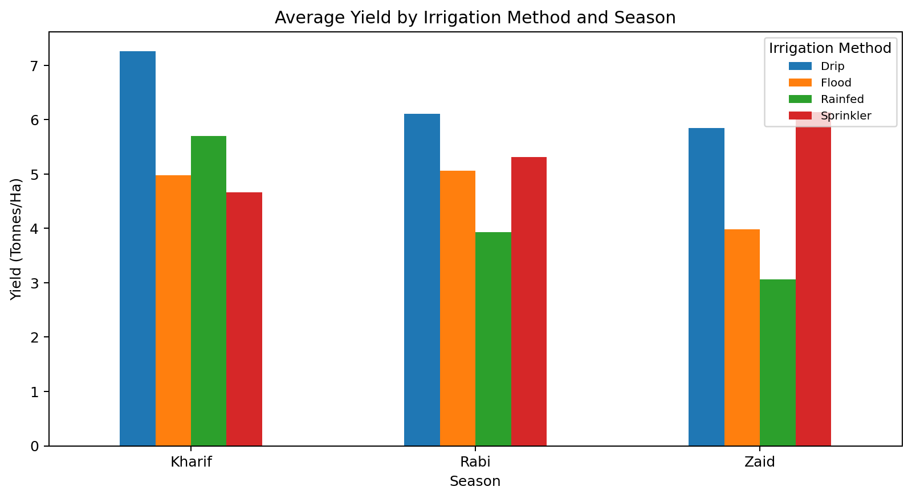
RESULTS
RESULT 5 – IRRIGATION & SEASONAL PERFORMANCE Irrigation performance was compared across seasons. The analysis helps identify how average yield differs by irrigation method and seasonal conditions. Drip irrigation showed strong performance in the examined seasonal groups, but results should be interpreted together with crop type and farm conditions.

Slide 11
Future scope
• Include multi-year historical data for time-series and trend analysis
• Add weather forecasts and real-time agricultural data
• Perform crop-specific and region-specific deep-dive analysis
• Develop interactive dashboards for seasonal monitoring
• Extend the work with predictive models for yield or profitability forecasting
• Incorporate additional variables such as market demand, soil nutrients and extreme weather events

Slide 12
GitHub Link
Project Repository
https://github.com/ShreeShanth2556/Seasonal-Agriculture-Performance-Analysis
The repository contains:
• README.md
• Project PDF
• Jupyter Notebook (.ipynb)
• Agricultural dataset (.csv)
• Project presentation (.pptx)

Slide 13
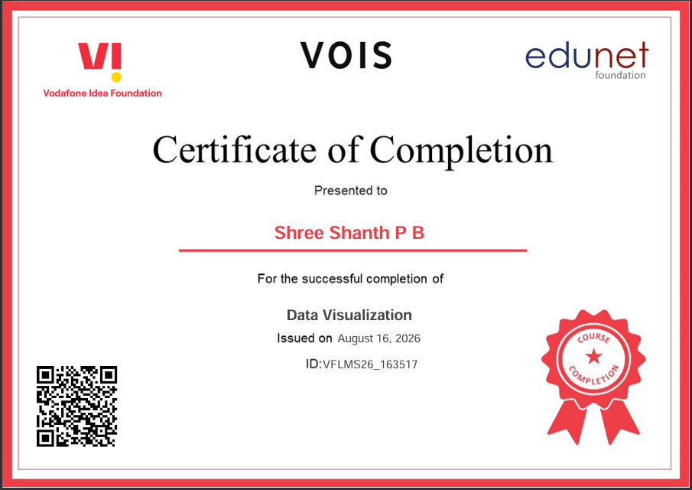
VOIS Course completion certificate - Course name- Data Visualization

Slide 14
Thank you

